Slide 1

Ambekeshwar Group Of Institution, Lucknow
PRESENTATION
ON
SUMMER TRAINING
WEB DEVELOPMENT USING PHP
ONLINE FOOD ORDERING SYSTEM
TEDHI-PULIA (U.P.)
PRESENTED BY:- SUBMITTED TO:-
Suraj Arya Ms. Fiza Hussain
Branch:- CSE 3rd Year (HOD CSE Dept.)

Slide 2
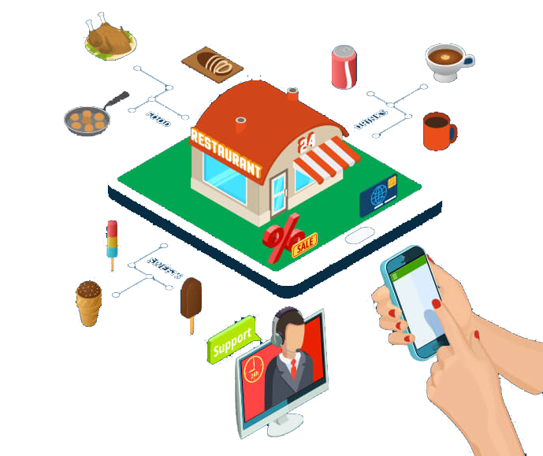
Introduction
An Online Food Ordering System simplifies the process of food ordering and delivery. It connects customers and restaurants through a digital platform, ensuring convenience and efficiency.

Slide 3

Research Analysis
Problem Statement
Traditional food ordering faces challenges such as:
Long waiting times
Miscommunication in orders
Limited options for customers
A digital solution is needed to overcome these issues.

Slide 4
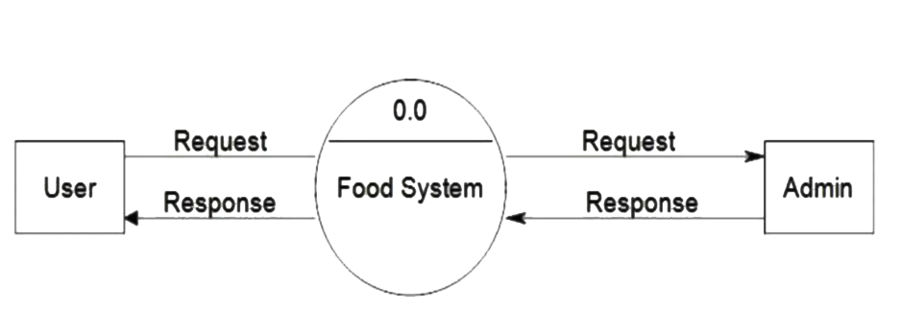
Design
Data Flow Diagram (0 Level DFD)
Fig. Level 0 DFD

Slide 5
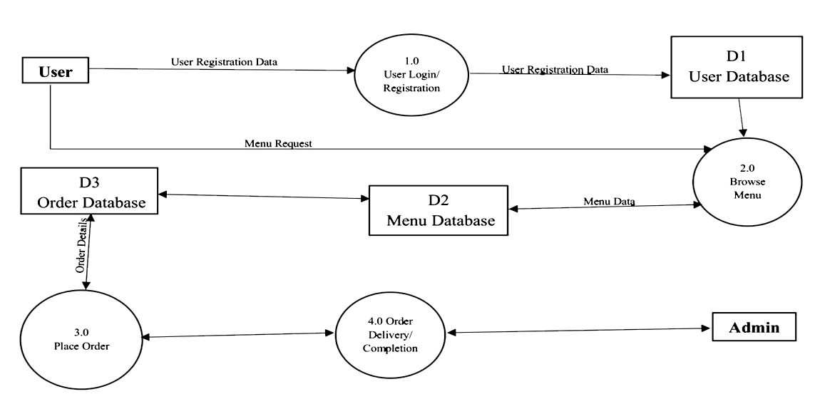
Data Flow Diagram (1 Level DFD)
Fig. Level 1 DFD

Slide 6
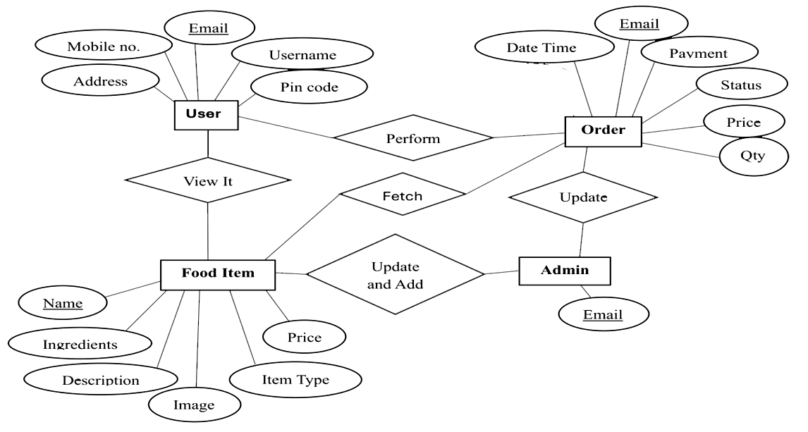
Entity-Relationship (ER) Diagram

Slide 7
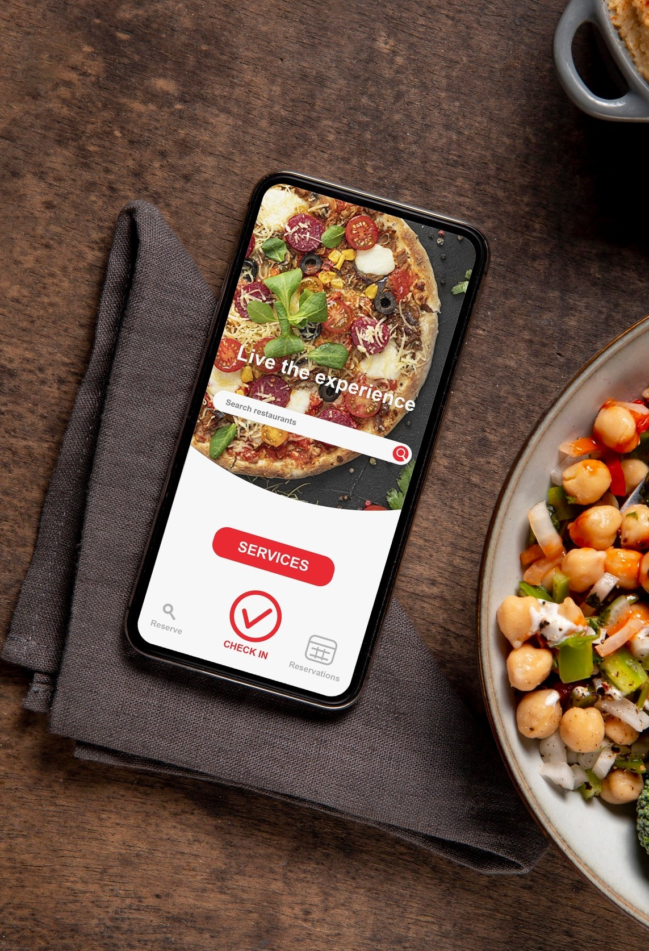
Software & Hardware Requirements
Technologies used:
Frontend: HTML, CSS, JavaScript
Backend: PHP
Database: MySQL
Tools Used:
Visual Studio Code (IDE)
XAMPP for testing and local server setup.

Slide 8
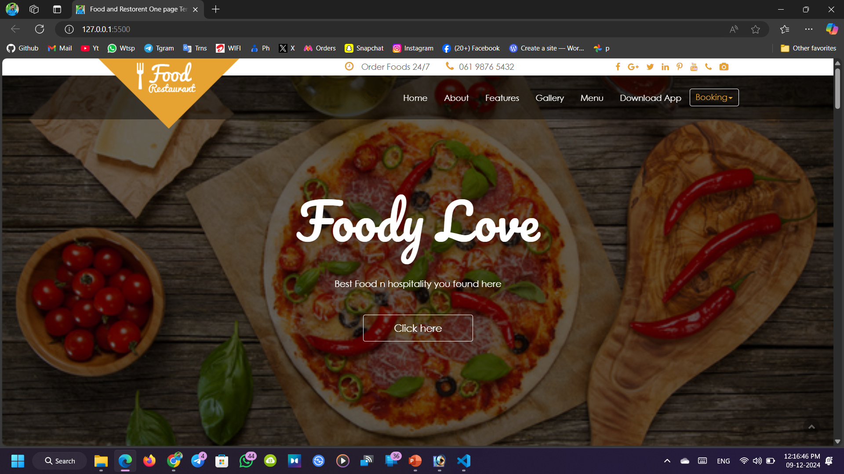
Result

Slide 9
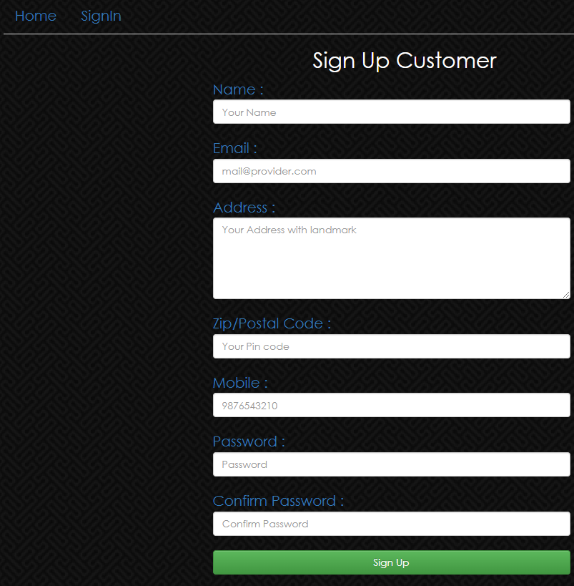
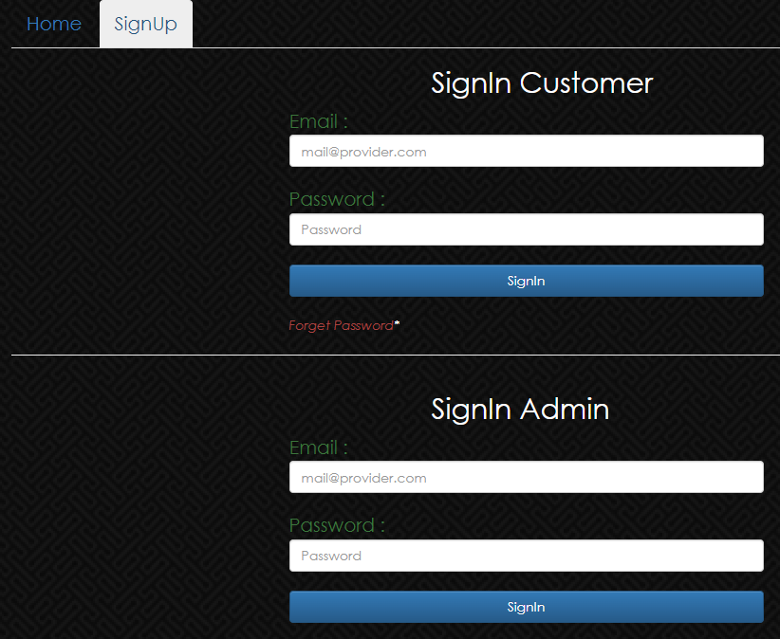
_{Create an account and log in.}

Slide 10
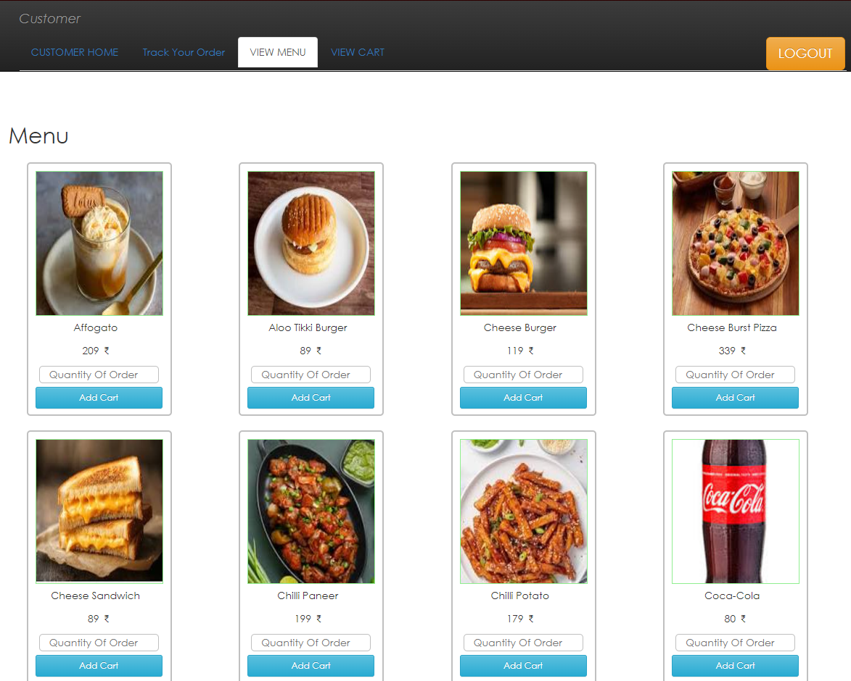
View a menu and select items to order.

Slide 11
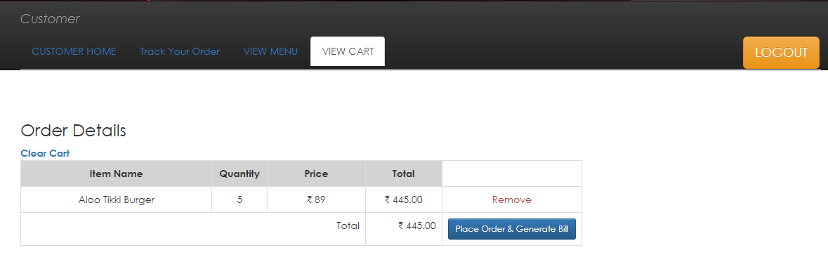
Place orders and view their order history.

Slide 12
Benefits
Benefits include:
Convenience and time-saving for customers
Increased revenue for restaurants
Reduced errors in order processing
Scalability for future enhancements

Slide 13
Conclusion and Future Scope
The Online Food Ordering System enhances the food delivery experience by providing convenience and efficiency.
Future additions may include:
AI-powered food recommendations
Delivery optimization with drones or robots
Adopt digital solutions to enhance customer satisfaction.

Slide 14
References
Tutorials and Documentation:
W3Schools for HTML, CSS, and JavaScript basics.
PHP documentation for backend development.
MySQL guides for database management.

Slide 15


